Slide 1
Process Management Process Abstraction
Lecture 2 (Live Version)

Slide 2
Overview
Introduction to Process Management
Process Abstraction:
Memory Context
Code & Data
Function call
Dynamically allocated memory
Hardware Context
OS Context
Process State
Process Control Block and Process Table
OS interaction with Process

Slide 3
Recap: Efficient Hardware Utilization
OS should provide efficient use of the hardware resource:
by managing the programs executing on the hardware
If there is only one program executing at any point in time, how can we utilize hardware resources effectively?
Solution:
Allow multiple programs to share the hardware

Slide 4
Introduction to Process Management
As the OS, to be able to switch from running program A to program B requires:
Information regarding the execution of program A needs to be stored
Program A's information is replaced with the information required to run program B
Hence, we need:
An abstraction to describe a running program
aka process

Slide 5
Key Topics
Process Abstraction
Process Scheduling
Inter-Process Communication & Synchronization
Information describing an executing program
Deciding which process get to execute
Passing information between processes
Alternative to Process
Light-weight process aka Thread

Slide 6
Process Abstraction
(Process / Task / Job) is a dynamic abstraction for executing program
information required to describe a running program
Memory Context
Code
Data
Hardware Context
Registers
PC
OS Context
Process Properties
Resources used
...
…
...

Slide 7
Recap: C Sample Program and Assembly Code
int i = 0;
i = i + 20;
C Program
lw $1, 4096
addi $1, $0, 0
sw $1, 4096
lw $2, 4096 addi $3, $2, 20
sw $3, 4096
Corresponding MIPS-like Assembly Code

Slide 8
Recap: Program Execution (Memory)
lw $1, 4096
addi $1, $1, 0
sw $1, 4096
lw $2, 4096
addi $3, $2, 20
sw $3, 4096
Text
(for instructions)
Data
(for global variables)
4096
The entire
memory space
"Free" Memory

Slide 9
Computer Organization: Review
Fetch Unit
Instruction Cache
Memory
Dispatch Unit
… … …
Functional Units
Registers
INT
FP
……
MEM
Data Cache
On CPU Chip
Off CPU Chip

Slide 10
Component Description
Memory:
Storage for instruction and data
Cache:
Duplicate part of the memory for faster access
Usually split into instruction cache and data cache
Fetch unit:
Loads instruction from memory
Location indicated by a special register:
Program Counter (PC)

Slide 11
Component Description (cont)
Functional units:
Carry out the instruction execution
Dedicated to different instruction type
Registers:
Internal storage for the fastest access speed
General Purpose Register (GPR):
Accessible by user program (i.e. visible to compiler)
Special Register:
Program Counter (PC)
Stack Pointer (SP)
Frame Pointer (FP)
Program Status Word (PSW)
etc

Slide 12
Basic Instruction Execution
Instruction X is fetched
Memory location indicated by Program Counter
Instruction X dispatched to the corresponding Functional Unit
Read operands if applicable
Usually from memory or GPR
Result computed
Write value if applicable
Usually to memory or GPR
Instruction X is completed
PC updated for the next instruction

Slide 13
Recap: What you should know ☺
An executable (binary) consists of two major components:
Instructions and Data
When a program is under execution, there are more information:
Memory context:
Text and Data, …
Hardware context:
General purpose registers, Program Counter, …
Actually, there are other types of memory usage during program execution

Slide 14
Memory Context Function Call
What if f() calls u() calls n()?

Slide 15
Function Call : Challenges
int g(int i, int j)
{
int a;
a = i + j
return a;
}
int i = 0;
i = i + 20;
VS
C Code Fragment
C Code with Function
Consider:
How do we allocate memory space for variables i, j and a?
Can we just make use of the "data" memory space?
What are the key issues?

Slide 16
Function Call : Control Flow and Data
void f( int a, int b )
{
int c;
c = g(a, b);
....
}
int g( int i, int j )
{
int a;
......
return ...;
}

Slide 17
Function Call : Control Flow and Data
Control Flow Issues:
Need to jump to the function body
Need to resume when the function call is done
Minimally, need to store the PC of the caller
Data Storage Issues:
Need to pass parameters to the function
Need to capture the return result
May have local variables declaration
➔ Need a new region of memory that dynamically used by function invocations
Notes:
new

Slide 18
Introducing Stack Memory
Stack Memory Region:
The new memory region to store information function invocation
Information of a function invocation is described by a stack frame
Stack frame contains:
Return address of the caller
Arguments (Parameters) for the function
Storage for local variables
Other information…. (more later)
Notes:
new

Slide 19
Stack Pointer
The top of stack region (first unused location) is logically indicated by a Stack Pointer:
Most CPU has a specialized register for this purpose
Stack frame is added on top when a function is invoked
Stack “grows” taller
Stack frame is removed from top when a function call ends
Stack "shrinks"

Slide 20
Illustration: Stack Memory
lw $1, 4096
addi $1, $1, 0
sw $1, 4096
lw $2, 4096
addi $3, $2, 20
sw $3, 4096
Text
(for instructions)
Data
(for global variables)
The entire
memory space
Stack growth direction
Stack Pointer
Stack
(for function invocations)

Slide 21
Illustration: Stack Memory Usage (1 / 5)
void f()
{
...
g();
...
}
At this point
void g()
{
h();
...
}
Stack Frame for f()
void h()
{
...
}
…
…

Slide 22
Illustration: Stack Memory Usage (2 / 5)
void f()
{
...
g();
...
}
void g()
{
h();
...
}
Stack Frame for g()
At this point
Stack Frame for f()
void h()
{
...
}
…
…

Slide 23
Illustration: Stack Memory Usage (3 / 5)
void f()
{
...
g();
...
}
Stack Frame for h()
void g()
{
h();
...
}
Stack Frame for g()
Stack Frame for f()
void h()
{
...
}
At this point
…
…

Slide 24
Illustration: Stack Memory Usage (4 / 5)
void f()
{
...
g();
...
}
void g()
{
h();
...
}
Stack Frame for g()
At this point
Stack Frame for f()
void h()
{
...
}
…
…

Slide 25
Illustration: Stack Memory Usage (5 / 5)
void f()
{
...
g();
...
}
At this point
void g()
{
h();
...
}
Stack Frame for f()
void h()
{
...
}
…
…

Slide 26
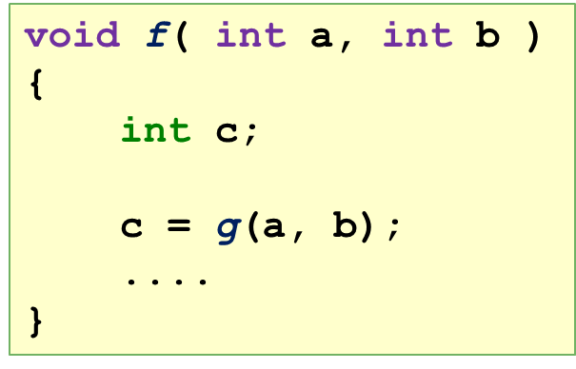
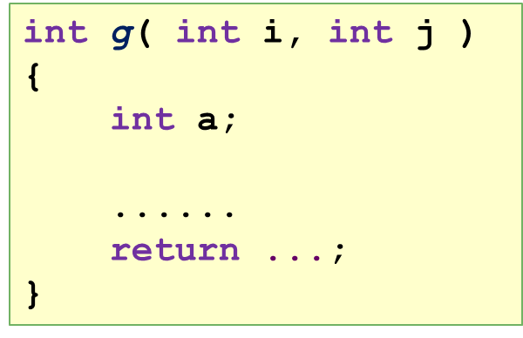
Illustration: Stack Frame v1.0
Free Memory
Stack Pointer
Local Variables
Parameters
Return PC
Stack Frame for g()
Stack
Other info
Stack Pointer
Stack Frame for f()
…
…

Slide 27
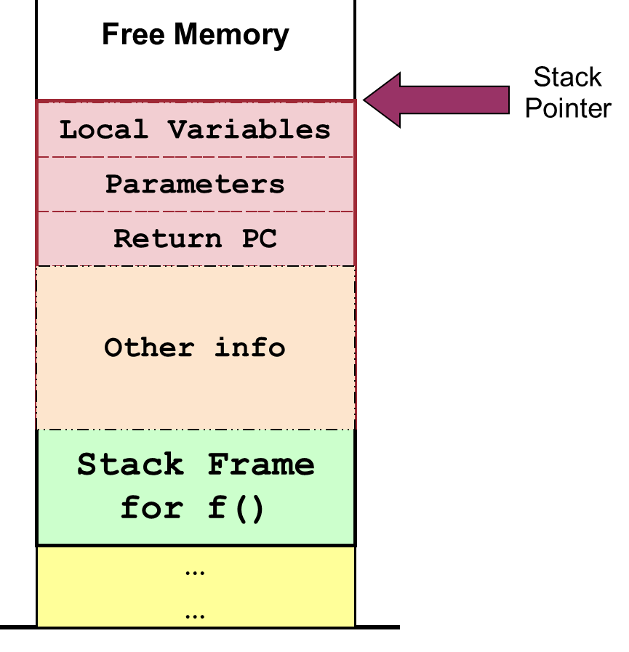
Function Call Convention
Different ways to setup stack frame:
No universal way
Hardware and programming language dependent
An example scheme is described next

Slide 28
Stack Frame Setup
Local Variable
Local Variable
Parameters
Parameters
Saved SP
Saved SP
Return PC
Return PC
Prepare to make a function call:
Caller: Pass parameters with registers and/or stack
Caller: Save Return PC on stack
Transfer Control from Caller to Callee
Callee: Save the old Stack Pointer (SP)
Callee: Allocate space for local variables of callee on stack
Callee: Adjust SP to point to new stack top
Notes:
Change the convention to match MIPS?

Slide 29
Illustration: Calling function g()
void f(int a, int b)
{
int c;
a = 123;
b = 456;
c = g(a, b);
....
}
int g(int i, int j)
{
int a;
a = i + j
return a * 2;
}
New SP
local var "a"
123
456
Saved SP
Return PC
Old SP
Stack Frame for f()

Slide 30
Stack Frame Teardown
Return Result
Local Variable
Parameters
Saved SP
Return PC
On returning from function call:
Callee: Place return result on stack (if applicable)
Callee: Restore saved Stack Pointer
Transfer control back to caller using saved PC
Caller: Utilize return result (if applicable)
Caller: Continues execution in caller
Notes:
Change the convention to match MIPS?

Slide 31
Illustration: Function g()finishes
void f(int a, int b)
{
int c;
a = 123;
b = 456;
c = g(a, b);
....
}
int g(int i, int j)
{
int a;
a = i + j
return a * 2;
}
1158
SP
579
123
Execution resumes here
456
Saved SP
Return PC
Restored SP
Stack Frame for f()

Slide 32
Other Information in Stack Frame
We have described the basic idea of:
Stack frame
Calling Convention: Setup and Teardown
Common additional information in the stack frame:
Frame Pointer
Saved Registers

Slide 33
Frame Pointer
To facilitate the access of various stack frame items:
Stack Pointer is hard to use as it can change
Some processors provide a dedicated register Frame Pointer
Frame pointer points to a fixed location in a stack frame
Other items are accessed as a displacement from the frame pointer
The usage of FP is platform dependent

Slide 34
Saved Registers
GPRs on most processors are very limited:
E.g. MIPS has 32 GPRs, x86 has 16 GPRs
When GPRs are exhausted:
Use memory to temporary hold the GPR value
That GPR can then be reused for other purpose
The GPR value can be restored afterwards
known as register spilling
Function can spill the registers it intend to use before the function starts
Restore those registers at the end of function

Slide 35
Illustration: Stack Frame v2.0
Free Memory
Stack Pointer
Local Variables
Parameters
Saved Registers
Frame Pointer
Stack Frame for g()
Stack
Saved SP
Saved FP
Return PC
Stack Frame for f()
After function f() calls g()
Topmost stack frame belongs to g()
…
…

Slide 36
Stack Frame Setup / Teardown [Updated]
On executing function call:
Caller: Pass arguments with registers and/or stack
Caller: Save Return PC on stack
Transfer control from caller to callee
Callee: Save registers used by callee. Save old FP, SP
Callee: Allocate space for local variables of callee on stack
Callee: Adjust SP to point to new stack top
On returning from function call:
Callee: Restore saved registers, FP, SP
Transfer control from callee to caller using saved PC
Caller: Continues execution in caller
Remember, just an example!
Notes:
Change the convention to match MIPS?

Slide 37
Function Call Summary
In this part, we learned:
Another portion of memory space is used as a Stack Memory
Stack Memory stores the executing function using Stack Frame
Typical information stored on a stack frame
Typical scheme of setting up and tearing down a stack frame
The usage of Stack Pointer and Frame Pointer

Slide 38
Memory Context Dynamically Allocated Memory
Hmm… I need more memory

Slide 39
Dynamically Allocated Memory
Most programming languages allow dynamically allocated memory:
i.e. acquire memory space during execution time
Examples:
In C, the malloc() function call
In C++, the new keyword
In Java, the new keyword
Question:
Can we use the existing "Data" or "Stack" memory regions?

Slide 40
Dynamically Allocated Memory
These memory blocks have different behaviors:
Allocated only at runtime ➔ Cannot place in Data region
No definite deallocation timing ➔ Cannot place in Stack region
Solution:
Setup a separate heap memory region

Slide 41
Illustration for Heap Memory
Text
(for instructions)
Data
(for global variables)
The entire
memory space
Heap
(for dynamic allocation)
Stack
(for function invocations)

Slide 42
Managing Heap Memory
Heap memory is a lot trickier to manage:
Variable size
Variable allocation / deallocation timing
Tricky scenario: heap memory are allocated /deallocated in such a way to create "holes" in the memory
Free memory block squeezed in between of occupied memory block
Discussed in the memory management (much) later in the course

Slide 43
Checkpoint: Contexts updated
Information describing a process:
Memory context:
Text, Data, Stack and Heap
Hardware context:
General purpose registers, Program Counter, Stack pointer, Stack frame pointer, ….

Slide 44
OS Context Process Id & Process State
Your ID? Give me a status report!

Slide 45
Process Identification
To distinguish processes from each other
Common approach is to use process ID (PID)
Unique among processes
There are a couple of OS dependent issues:
Are PIDs reused?
Does it limit the maximum no. of processes?
Are there reserved PIDs?

Slide 46
Introducing Process State
In the multitasking scenario:
A process can be:
Running OR
Not-running
A process can be ready to run
But not actually executing
Hence, each process should have a process state:
As an indication of the execution status

Slide 47
(Simple) Process Model State Diagram
context switch
Ready
Running
context switch
The set of states and transitions are known as process model

Slide 48
Generic 5-State Process Model
Terminated
New
admit
switch: scheduled
exit
create
Ready
Running
switch: release
CPU
event wait
event occurs
Blocked

Slide 49
Process States for 5-Stage Model
New:
New process created
May still be under initialization ➔ not yet ready
Ready:
process is waiting to run
Running:
Process being executed on CPU
Blocked:
Process waiting (sleeping) for event
Cannot execute until event is available
Terminated:
Process has finished execution, may require OS cleanup

Slide 50
Process State Transitions in 5-Stage Model
Create (nil → New):
New process is created
Admit (New → Ready):
Process ready to be scheduled for running
Switch (Ready → Running):
Process selected to run
Switch (Running → Ready):
Process gives up CPU voluntarily or preempted by scheduler

Slide 51
Process State Transitions
Event wait (Running → Blocked):
Process requests event/resource/service which is not available/in progress
Example events:
System call, waiting for I/O, (more later)
Event occurs (Blocked → Ready):
Event occurs ➔ process can continue

Slide 52
Global View of Process States
Given n processes:
With 1 CPU:
≤ 1 process in running state
conceptually 1 transition at a time
With m CPUs:
≤ m process in running state
possibly parallel transitions
Different processes may be in different states
each process may be in different part of its state diagram

Slide 53
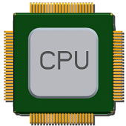
Queuing Model of 5 State Transition
ready
queue
Running
Process
exit
admit
switch
by scheduler
release cpu
event wait
blocked
queue
Notes:
Beautify

Slide 54
Checkpoint: Contexts updated
When a program is under execution, there are more information:
Memory context:
Text and Data, Stack and Heap
Hardware context:
General purpose registers, Program Counter, Stack pointer, Stack frame pointer, …
OS context:
Process ID, Process State, …

Slide 55
Process Table & Process Control Block
Putting it together

Slide 56
Process Control Block & Table
The entire execution context for a process
Process Control Block (PCB) or Process Table Entry
Kernel maintains PCB for all processes
Conceptually stored as one table representing all processes
Interesting Issues:
Scalability
How many concurrent processes can you have?
Efficiency
Should provide efficient access with minimum space wastage

Slide 57
Illustration: Process Table
PC, FP, SP, ……
Text
GPRs
PCB₁
Memory Region Info
Data
PCB₂
PCB₃
PID
Heap
Process State
………
Process Control Block
Process Table
Stack
Memory Space of a Process

Slide 58
Process interaction with OS System Calls
Can you please do this for me?

Slide 59
System Calls
Application Program Interface (API) to OS
Provides way of calling facilities/services in kernel
NOT the same as normal function call
have to change from user mode to kernel mode
Different OS have different APIs:
Unix Variants:
Most follows POSIX standards
Small number of calls: ~100
Windows Family:
Uses Win API across different Windows versions
New version of windows usually adds more calls
Huge number of calls: ~1000

Slide 60
Unix System Calls in C/C++ program
In C/C++ program, system call can be invoked almost directly
Library version with the same name and the same parameters
The library version act as a function wrapper
User Friendly Library version
The library version acts as a function adapter

Slide 61
Example ( Unix System Calls )
#include <unistd.h>
#include <stdio.h>
int main()
{
int pid;
/* get Process ID */
pid = getpid();
printf("process id = %d\n", pid);
return 0;
}
System Calls in this example:
getpid()
write() – made by printf() library call

Slide 62
General System Call Mechanism
User program invokes the library call
Using the normal function call mechanism as discussed
Library call (usually in assembly code) places the system call number in a designated location
E.g. Register
Library call executes a special instruction to switch from user mode to kernel mode
That instruction is commonly known as TRAP

Slide 63
General System Call Mechanism (cont)
Now in kernel mode, the appropriate system call handler is determined:
Using the system call number as index
Similar to the vectored interrupt
This step is usually handled by a dispatcher
System call handler is executed:
Carry out the actual request
System call handler ended:
Control return to the library call
Switch from kernel mode to user mode
Library call return to the user program:
via normal function return mechanism

Slide 64
System Call Mechanism Illustration
registerX
int getpid()
{
Setup SysCall Number
TRAP
...
return ...
}
...
int main()
{
...
getpid();
...
}
Dispatcher()
{
Call the right handler
}
Dispatcher()
{
Call Handlers[SysNum];
}
Call the right handler
SystemCallHandlerXXX()
{
Perform the task
}
User Mode
Kernel Mode

Slide 65
Process interaction with OS Exception and Interrupt
Ops!

Slide 66
Exception
Executing a machine level instruction can cause exception
Examples:
Arithmetic Errors: Overflow, Underflow, Division by Zero
Memory Errors: Illegal memory address, Mis-alignment memory access
Exception is Synchronous
Occur due to program execution
Effect of exception:
An exception handler is executed automatically
Similar to a forced function call

Slide 67
Interrupt
External events can interrupt the execution of a program
Usually hardware related, e.g.:
Timer, Mouse Movement, Keyboard Pressed etc
Interrupt is asynchronous
Events that occurs independent of program execution
Effect of interrupt:
Program execution is suspended
An interrupt handler is executed automatically

Slide 68
Exception/Interrupt Handler: Illustration
void f()
{
...
Statement S1;
...
}
Exception/Interrupt occurs:
Control transfer to a handler routine automatically
Return from handler routine:
Program execution resume
May behave as if nothing happened
void handler()
{
1. Save Register/CPU state
2. Perform the handler routine
3. Restore Register/CPU
4. Return from interrupt
}

Slide 69
Summary
Using process as an abstraction of running program:
Necessary information (environment) of execution
Memory, Hardware and OS contexts
Process from OS perspective:
PCB and process table
OS ⬅ ➔ Process interactions
System calls
Exception / Interrupt

Slide 70
Reference
Modern Operating System (3rd Edition)
Section 2.1
Operating System Concepts (8th Edition)
Section 3.1

Slide 71
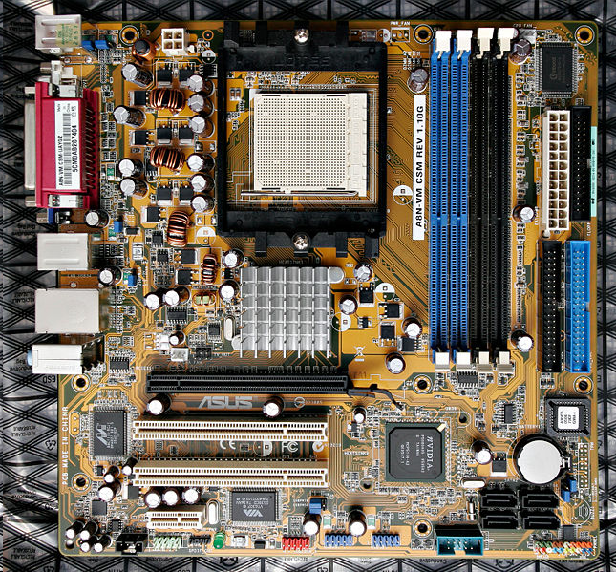
Computer Organization – Whoa?!
E

Slide 72
Basic Instruction Execution
Fetch Unit
Memory
1200 | lw $1, 4096
1204 | addi $1, $0, 0 1208 | sw $1, 4096
1212 | lw $2, 4096 1216 | addi $3, $2, 20
1220 | sw $3, 4096
...
Dispatch Unit
… … …
$1
……
Functional Units
$2
Registers
$3
... |
4096 | 999
... |
$4
$5
PC
E

Slide 73
Function Call : Challenges
int i = 0;
i = i + 20;
Text
C Code Fragment
Data
int g(int i, int j)
{
int a;
a = i + j
return a;
}
C Code with Function
E

Slide 74
Quiz 1: Refer to Quiz 1
E

Slide 75
Function Call: The BIG picture
Fetch Unit
Memory
1200 |
...
Dispatch Unit
… … …
... |
4096 |
... |
$1
……
Functional Units
$2
Registers
$3
... |
XXXX |
... |
SP
FP
PC
E

Slide 76
Illustration: Memory Regions
Text
(for instructions)
Data
(for global variables)
The entire
memory space
Stack
(for function invocations)
E

Slide 77
Lecture 1: Still remember this?
System Processes
User Programs
E
D
Library
C
C
OS
A
B
B
Hardware
A: OS executing machine instructions
B: normal machine instructions executed (program/library code)
C: calling OS using system call interface
D: user program calls library code
E: system processes
Provide high level services, usually part of OS
E

Slide 78
Recap: Program Execution (Memory)
Text
void f( int a, int b )
{
int c;
g( a, b );
....
}
Data
void g( int i, int j )
{
int a;
......
return;
}
E

Slide 79
Process Table MORE
PC, FP, SP, ……
Text
GPRs
Data
Memory Region Info
Heap
PID
Stack
Process State
PC, FP, SP, ……
Text
PCB₁
GPRs
Data
PCB₂
PCB₃
Memory Region Info
Heap
………
PID
Stack
Process Table
Process State
E

